Slide 1
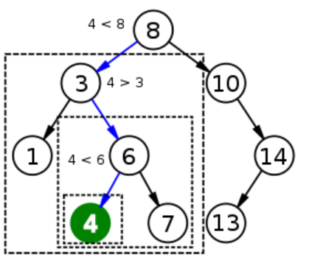
Solution 3: Network Hi Lo

Slide 2
Server
import socket
import random
import TCPUtils
server = socket.socket(socket.AF_INET, socket.SOCK_STREAM)
server.bind( ("", 1234))
server.listen(1)
client, addr = server.accept()
print 'Connection address:', addr
number = random.randint(1,101)
print "My number is ",number
while True:
print "Waiting for guess"
guess = TCPUtils.readString(client)
clientGuess = int(guess)
print "Guess is ",guess
if clientGuess < number:
TCPUtils.sendString(client,"Higher")
print "Higher"

Slide 3
Server
elif clientGuess > number:
TCPUtils.sendString(client,"Lower")
print "Lower"
else:
TCPUtils.sendString(client,"You guessed it")
print "Got it"
break
print "Ending"
client.close()
server.close()

Slide 4
Client
import socket
import TCPUtils
client = socket.socket(socket.AF_INET,
socket.SOCK_STREAM)
client.connect( ("localhost",1234) )
print "The server is thinking of a number between 1 and 100."
print "Try and guess it!"
print ""
while True:
guess = raw_input("Your guess: ")
TCPUtils.sendString(client,guess)
resp = TCPUtils.readString(client)
print "Server says: ", resp
if resp == "You guessed it":
break
client.close()

Slide 5
Simple Auto Client
import socket
import TCPUtils
client = socket.socket(socket.AF_INET, socket.SOCK_STREAM)
client.connect( ("localhost",1234) )
for x in range(1,101):
TCPUtils.sendString(client,str(x))
resp = TCPUtils.readString(client)
print x, resp
if resp == "You guessed it":
break
client.close()

Slide 6
Binary Search Client
import socket
import TCPUtils
client = socket.socket(socket.AF_INET, socket.SOCK_STREAM)
client.connect( ("localhost",1234) )
start = 1
end = 100
while True:
guess = ((end - start) / 2) + start
print guess
lastGuess = guess
TCPUtils.sendString(client,str(guess))
resp = TCPUtils.readString(client)
if resp == "Higher":
start = guess
elif resp == "Lower":
end = guess
else:
break
client.close()

